Slide 1
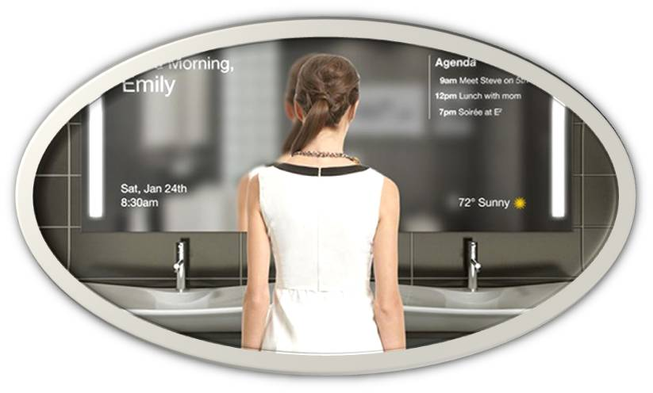
Smart mirror
Presentation by LAM Jean STI2DD

Slide 2
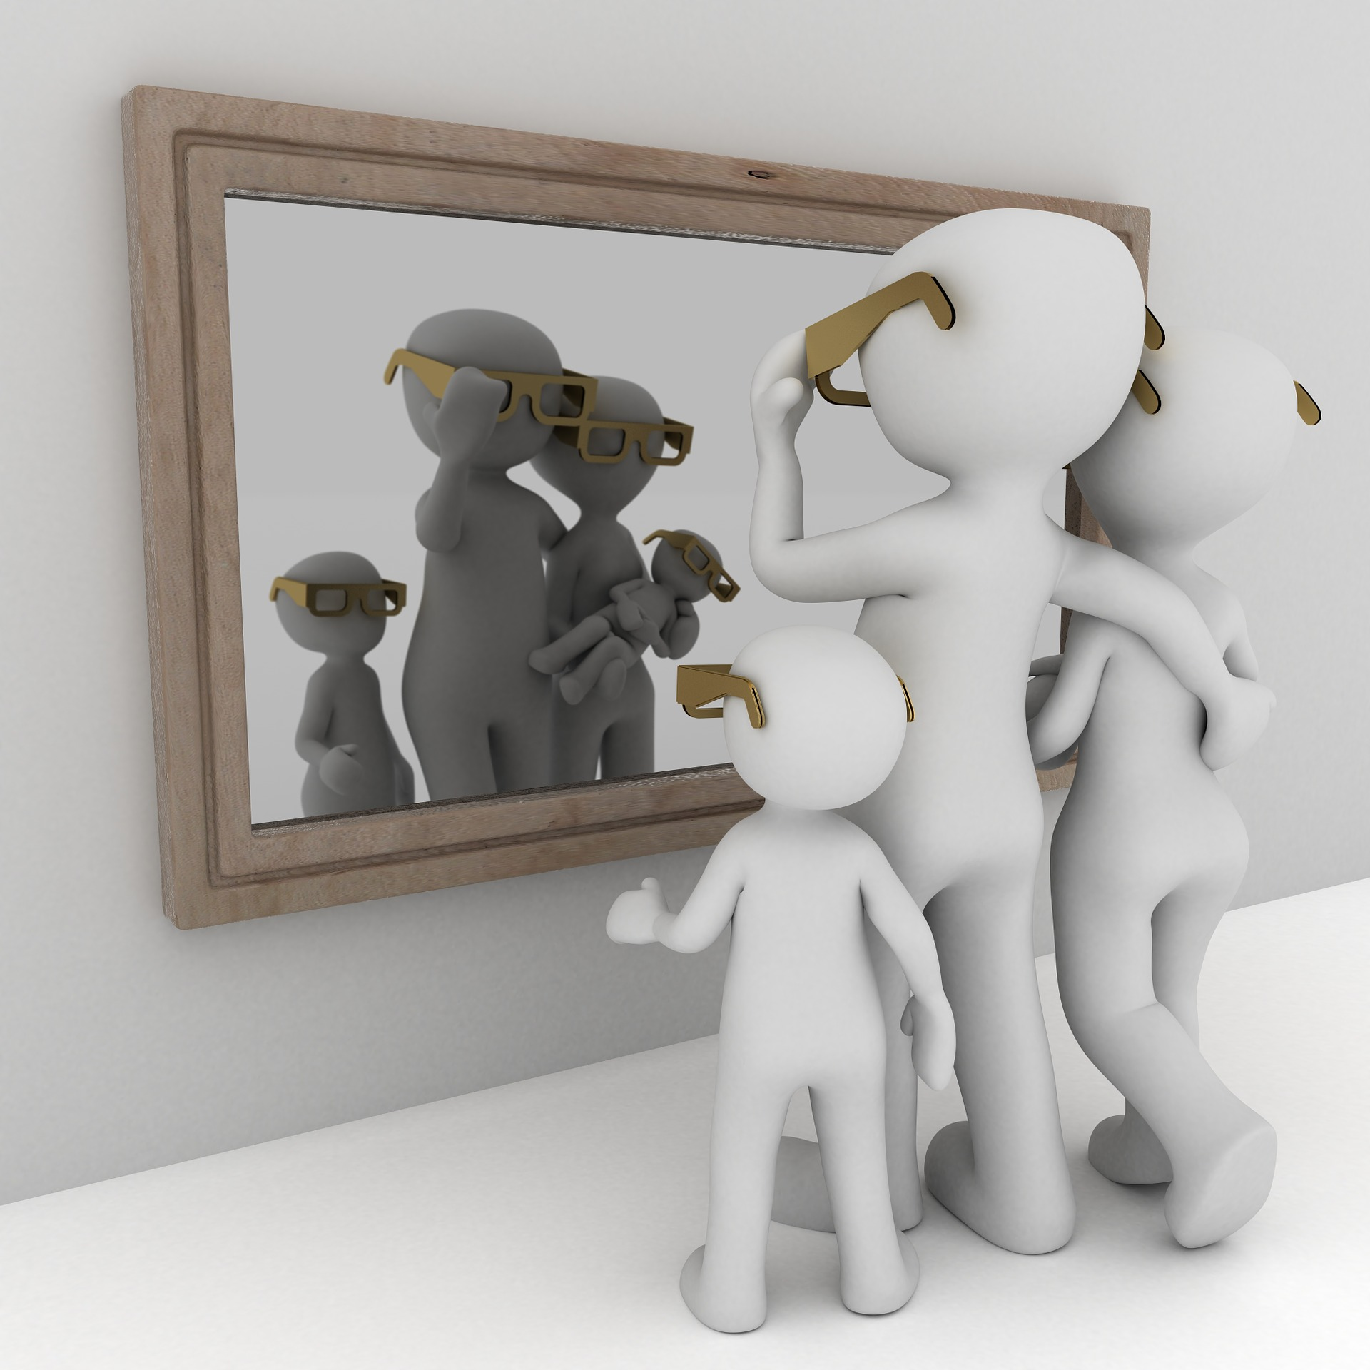
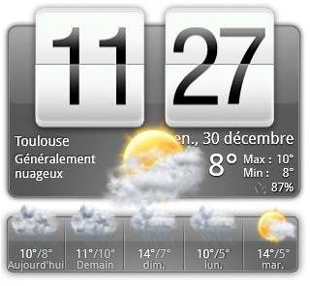
The aim of the project
Providing useful informations to the user:
Health information about the user.
Date, road traffic, weather, etc…
While still doing its primal function.
With a 300€ budget.

Slide 3
Distribution of tasks
Speech Recognition
Health
Detecting Individuals
Facial Recognition
User Interface
Mirror Design

Slide 4
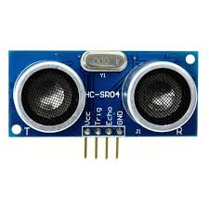
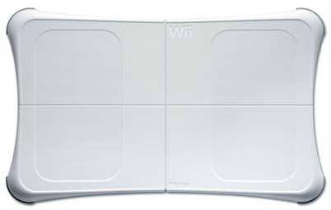
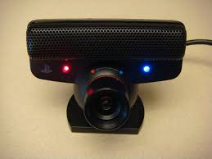
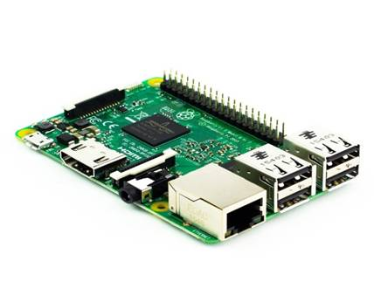
Materials used
Ultrasonic sensor.
Balance with bluetooth support.
Webcam with usb port.
Raspberry pi 3 PC board.

Slide 5
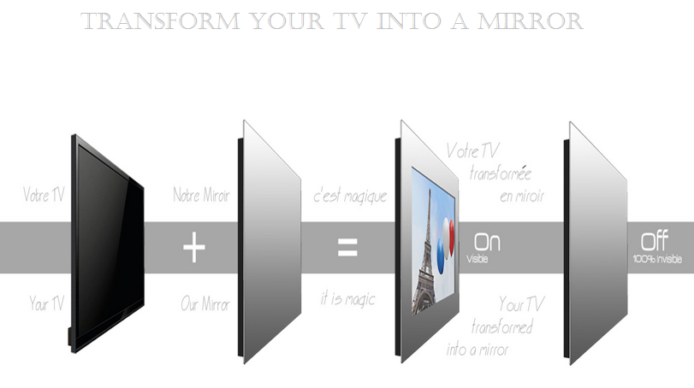
Materials used

Slide 6
Works done
Speech recognition with some voice commands.
Calculation of the user ’s weight with several health information depending of it.
Detection of people or objects.

Slide 7
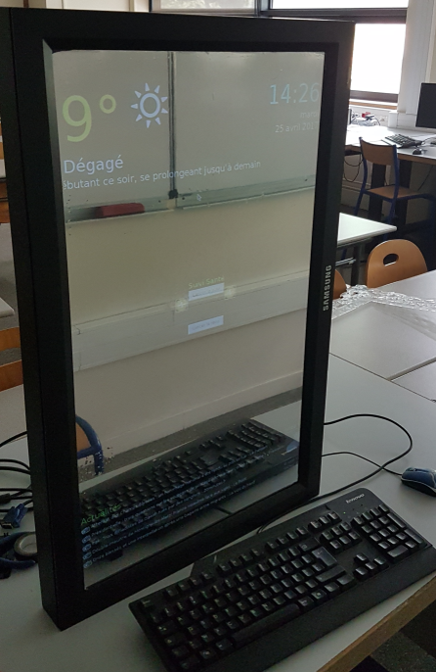
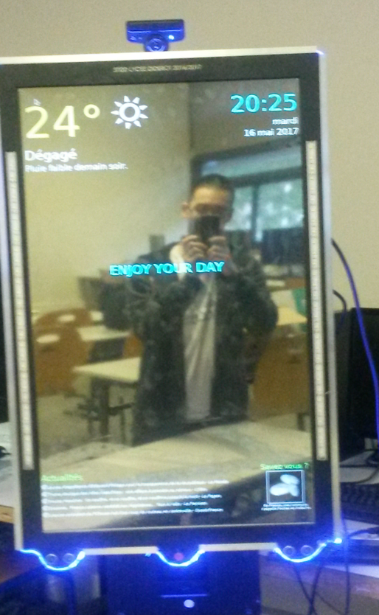
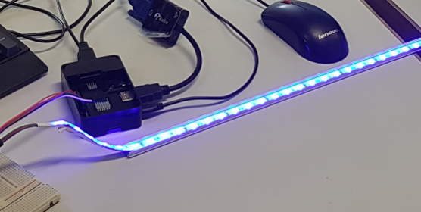
Result

Slide 8
Works in progress
Adding voice commands.
User interface.
Putting the facial recognition to our main program.

Slide 9
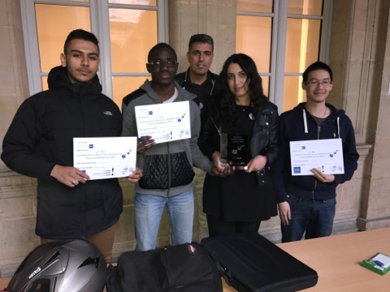
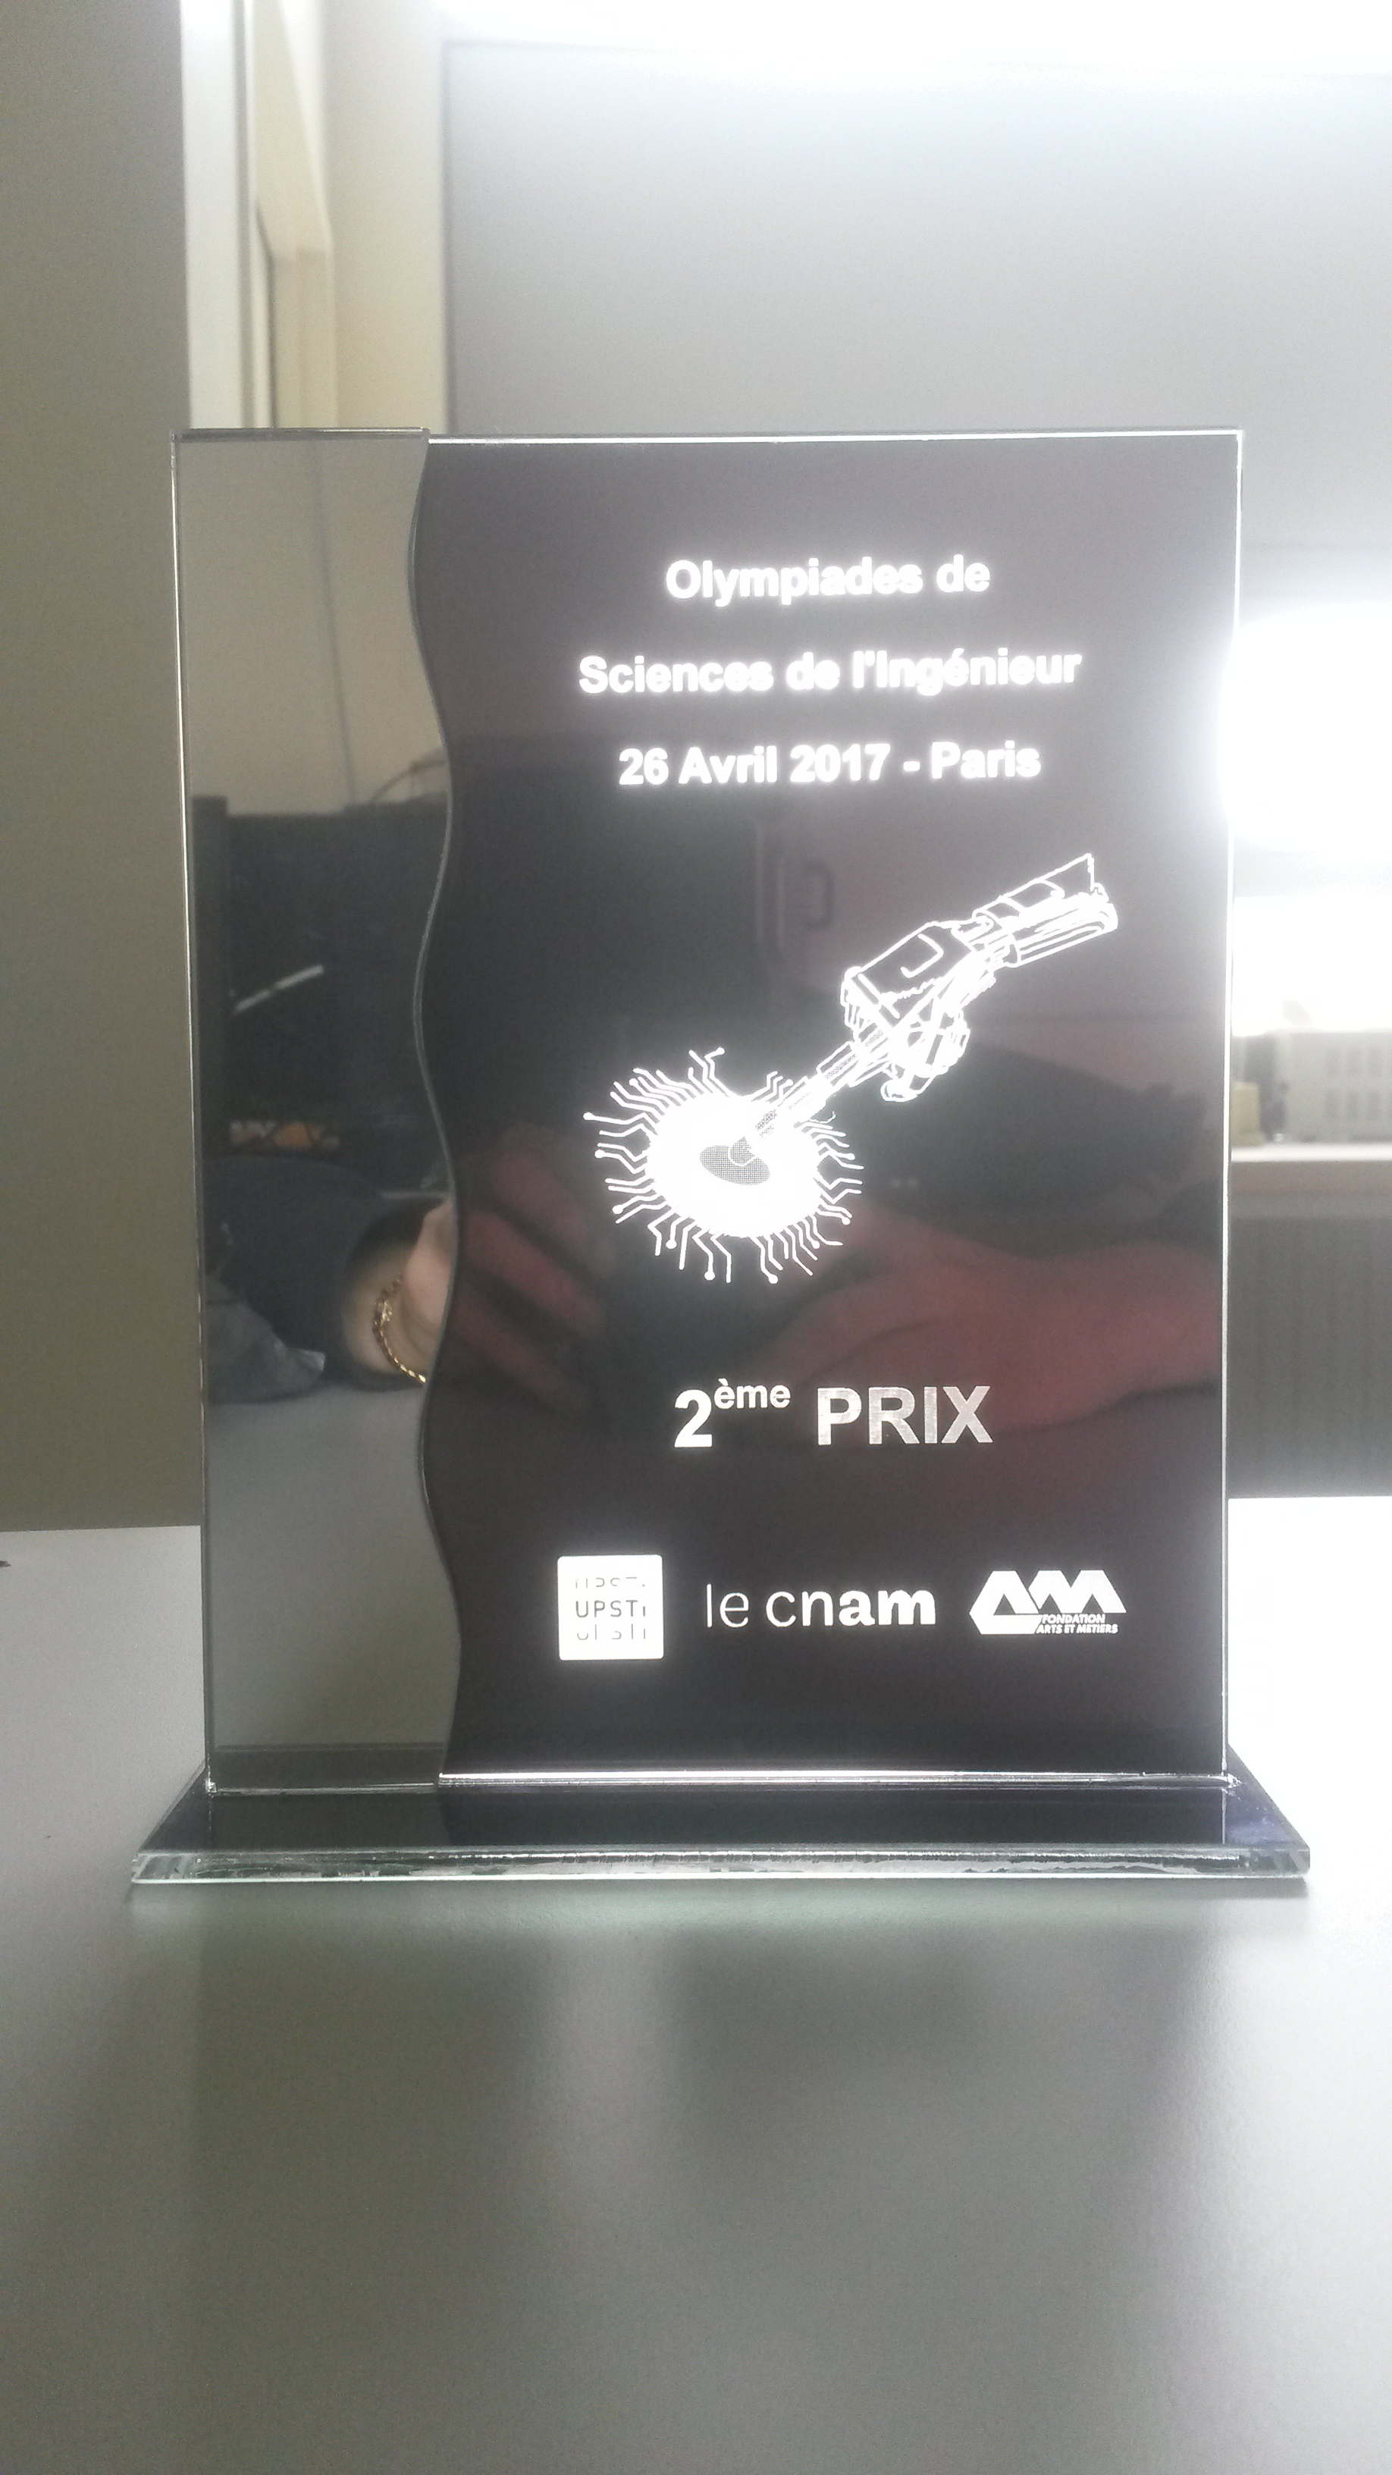
Thank you for listening

